Slide 1

Programming Languages
Third Edition
Chapter 5
Object-Oriented Programming

Slide 2
Objectives
Understand the concepts of software reuse and independence
Become familiar with the Smalltalk language
Become familiar with the Java language
Become familiar with the C++ language
Understand design issues in object-oriented languages
Understand implementation issues in object-oriented languages
Programming Languages, Third Edition

Slide 3
Introduction
Object-oriented programming languages began in the 1960s with Simula
  Goals were to incorporate the notion of an object, with properties that control its ability to react to events in predefined ways
  Factor in the development of abstract data type mechanisms
  Crucial to the development of the object paradigm itself
Programming Languages, Third Edition

Slide 4
Introduction (cont’d.)
By the mid-1980s, interest in object-oriented programming exploded
  Almost every language today has some form of structured constructs
Programming Languages, Third Edition

Slide 5
Software Reuse and Independence
Object-oriented programming languages satisfy three important needs in software design:
  Need to reuse software components as much as possible
  Need to modify program behavior with minimal changes to existing code
  Need to maintain the independence of different components
Abstract data type mechanisms can increase the independence of software components by separating interfaces from implementations
Programming Languages, Third Edition

Slide 6
Software Reuse and Independence (cont’d.)
Four basic ways a software component can be modified for reuse:
  Extension of the data or operations
  Redefinition of one or more of the operations
  Abstraction
  Polymorphism
Extension of data or operations:
  Example: adding new methods to a queue to allow elements to be removed from the rear and added to the front, to create a double-ended queue or deque
Programming Languages, Third Edition

Slide 7
Software Reuse and Independence (cont’d.)
Redefinition of one or more of the operations:
  Example: if a square is obtained from a rectangle, area or perimeter functions may be redefined to account for the reduced data needed
Abstraction, or collection of similar operations from two different components into a new component:
  Example: can combine a circle and rectangle into an abstract object called a figure, to contain the common features of both, such as position and movement
Programming Languages, Third Edition

Slide 8
Software Reuse and Independence (cont’d.)
Polymorphism, or the extension of the type of data that operations can apply to:
  Examples: overloading and parameterized types
Application framework: a collection of related software resources (usually in object-oriented form) for developer use
  Examples: Microsoft Foundation Classes in C++ and Swing windowing toolkit in Java
Programming Languages, Third Edition

Slide 9
Software Reuse and Independence (cont’d.)
Object-oriented languages have another goal:
  Restricting access to internal details of software components
Mechanisms for restricting access to internal details have several names:
  Encapsulation mechanisms
  Information-hiding mechanisms
Programming Languages, Third Edition

Slide 10
Smalltalk
Smalltalk originated from the Dynabook Project at Xerox Corp.’s Palo Alto Research Center in the early 1970s
  Dynabook was conceived as a prototype of today’s laptop and tablet computers
Smalltalk was influenced by Simula and Lisp
ANSI standard was achieved in 1998
Smalltalk has the most consistent approach to object-oriented paradigm
  Everything is an object, including constants and the classes themselves
Programming Languages, Third Edition

Slide 11
Smalltalk (cont’d.)
Can be said to be purely object-oriented
Includes garbage collection and dynamic typing
Includes a windowing system with menus and a mouse, long before this became common for PCs
Is an interactive and dynamically oriented language
  Classes and objects are created by interaction with the system, using a set of browser windows
  Contains a large hierarchy of preexisting classes
Programming Languages, Third Edition

Slide 12
Basic Elements of Smalltalk: Classes, Objects, Messages, and Control
Every object in Smalltalk has properties and behaviors
Message: a request for service
Receiver: object that receives a message
Method: how Smalltalk performs a service
Sender: originator of the message
  May supply data in the form of parameters or arguments
Mutators: messages that result in a change of state in the receiver object
Programming Languages, Third Edition

Slide 13
Basic Elements of Smalltalk (cont’d.)
Message passing: process of sending and receiving messages
Interface: the set of messages that an object recognizes
Selector: the message name
Syntax: object receiving the message is written first, followed by the message name and any arguments
Example: create a new set object:
  Set new “Returns a new set object”
Programming Languages, Third Edition

Slide 14
Basic Elements of Smalltalk (cont’d.)
Comments are enclosed in double quotation marks
Show it option: causes Smalltalk to evaluate the code you have entered
size message: returns the number of elements in a set
Can send multiple messages
  Example: Set new size “Returns 0”
  Set class receives the new message and returns an instance of Set, which receives the size message and returns an integer
Programming Languages, Third Edition

Slide 15
Basic Elements of Smalltalk (cont’d.)
Class message: a message sent to a class
Instance message: a message sent to an instance of a class
In prior example, new is a class message, while size is an instance message
Unary message: one with no arguments
Keyword messages: messages that expect arguments; name ends in a colon
  Example:
  Set new includes: ‘Hello’ “Returns false”
Programming Languages, Third Edition

Slide 16
Basic Elements of Smalltalk (cont’d.)
If there is more than one argument, another keyword must precede each argument
  Keyword at:put: expects two arguments
Unary messages have a higher precedence than keyword messages
  Parentheses can be used to override precedence
Binary messages: allow you to write arithmetic and comparison expressions with infix notation
Programming Languages, Third Edition

Slide 17

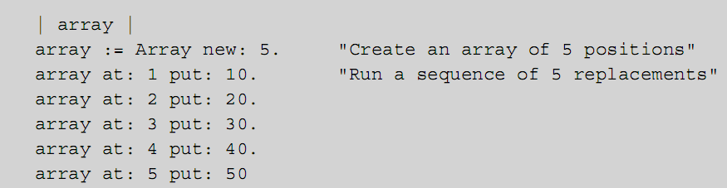
Basic Elements of Smalltalk (cont’d.)
Examples:
Can use variables to refer to objects
Example:
Programming Languages, Third Edition

Slide 18
Basic Elements of Smalltalk (cont’d.)
Temporary variables are declared between vertical bars and are not capitalized
Statements are separated by periods
Smalltalk variables have no assigned data type
  Any variable can name any thing
Assignment operator is :=
  Same as Pascal and Ada
Programming Languages, Third Edition

Slide 19
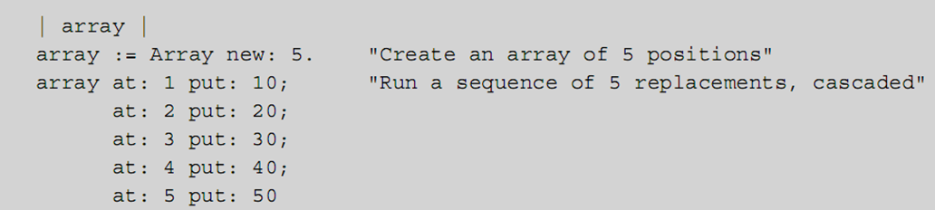
Basic Elements of Smalltalk (cont’d.)
A sequence of messages to the same object are separated by semicolons:
Smalltalk’s variables use reference semantics, not value semantics
  A variable refers to an object; it does not contain an object
Programming Languages, Third Edition

Slide 20
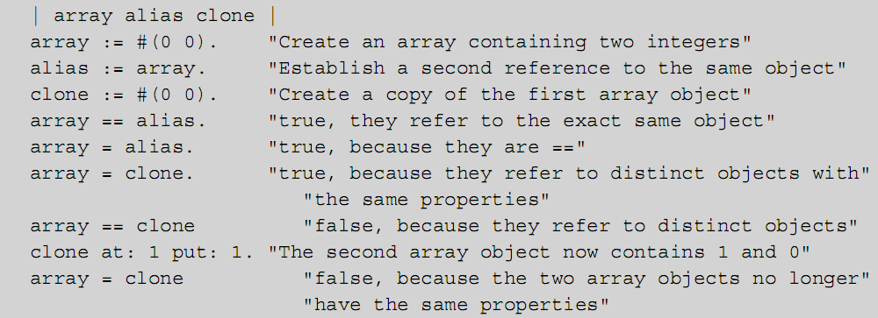
Basic Elements of Smalltalk (cont’d.)
Equality operator is =
Object identity operator is ==
Programming Languages, Third Edition

Slide 21
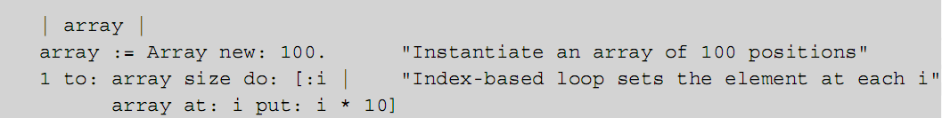
Basic Elements of Smalltalk (cont’d.)
to:do creates a loop
Block of code is enclosed in brackets [ ]
  Block is similar to a lambda form in Scheme
  Can contain arguments as block variables
In Smalltalk, even control statements are expressed in terms of message passing
Programming Languages, Third Edition

Slide 22
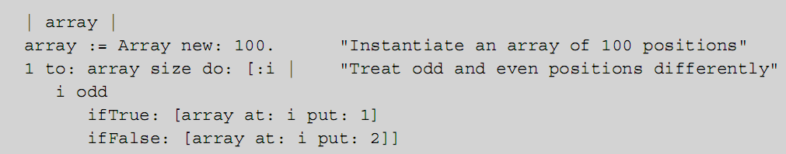
Basic Elements of Smalltalk (cont’d.)
ifTrue:ifFalse messages express alternative courses of action
To print the contents of an array:
Smalltalk includes many types of collection classes and messages for performing iterations
Programming Languages, Third Edition

Slide 23
The Magnitude Hierarchy
Built-in classes are organized in a tree-like hierarchy
  Root class is called Object
  Classes descend from more general to more specific
Inheritance: supports the reuse of structure and behavior
Polymorphism: the use of the same names for messages requesting similar services from different classes
  Another form of code reuse
Programming Languages, Third Edition

Slide 24
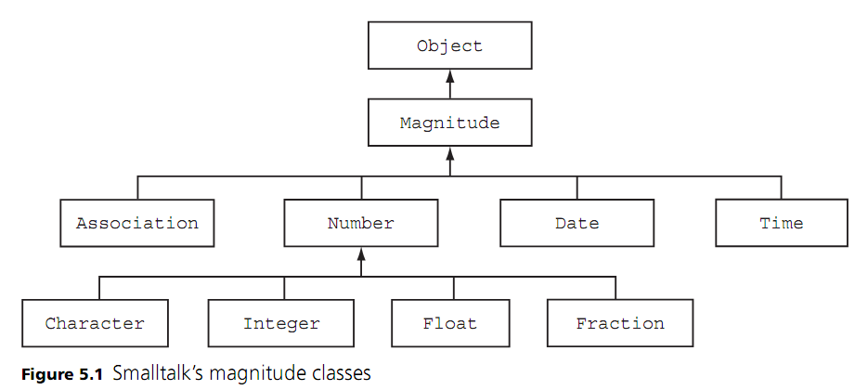
The Magnitude Hierarchy (cont’d.)
Programming Languages, Third Edition

Slide 25
The Magnitude Hierarchy (cont’d.)
Concrete classes: classes whose objects are normally created and manipulated by programs
  Examples: Time and Date
Abstract classes: serve as repositories of common properties and behaviors for classes below them in the hierarchy
  Examples: Magnitude and Number
Can use the Smalltalk class browser to see how classes and their methods are defined
Programming Languages, Third Edition

Slide 26
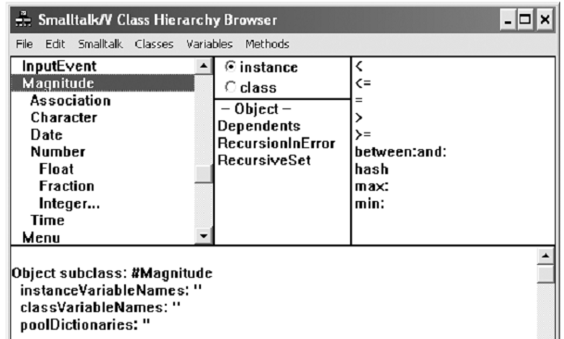

The Magnitude Hierarchy (cont’d.)
Programming Languages, Third Edition

Slide 27
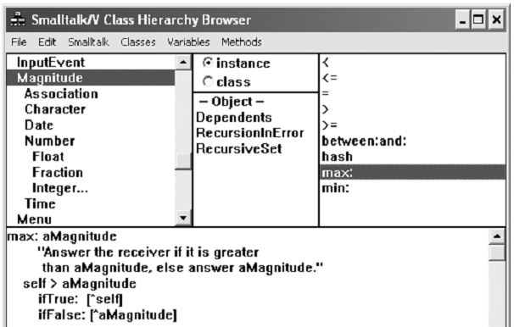

Programming Languages, Third Edition

Slide 28
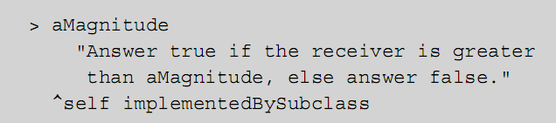
The Magnitude Hierarchy (cont’d.)
If we select the > operator in the message list:
When a message is sent to an object, Smalltalk binds the message name to the appropriate method
Dynamic or runtime binding: important key to organizing code for reuse in object-oriented systems
Programming Languages, Third Edition

Slide 29
The Magnitude Hierarchy (cont’d.)
To use inheritance, build a new class from an existing one
Use Add Subclass option in the Classes menu to define a new class via inheritance
Programming Languages, Third Edition

Slide 30
The Collection Hierarchy
Collections are containers whose elements are organized in a specific manner
  Organization types include linear, sorted, hierarchical, graph, and unordered
Built-in collections in imperative languages have historically been limited to arrays and strings
Smalltalk provides a large set of collection types, organized in a class hierarchy
The basic iterator is do:
  It is implemented by subclasses that vary with the type of collection
Programming Languages, Third Edition

Slide 31
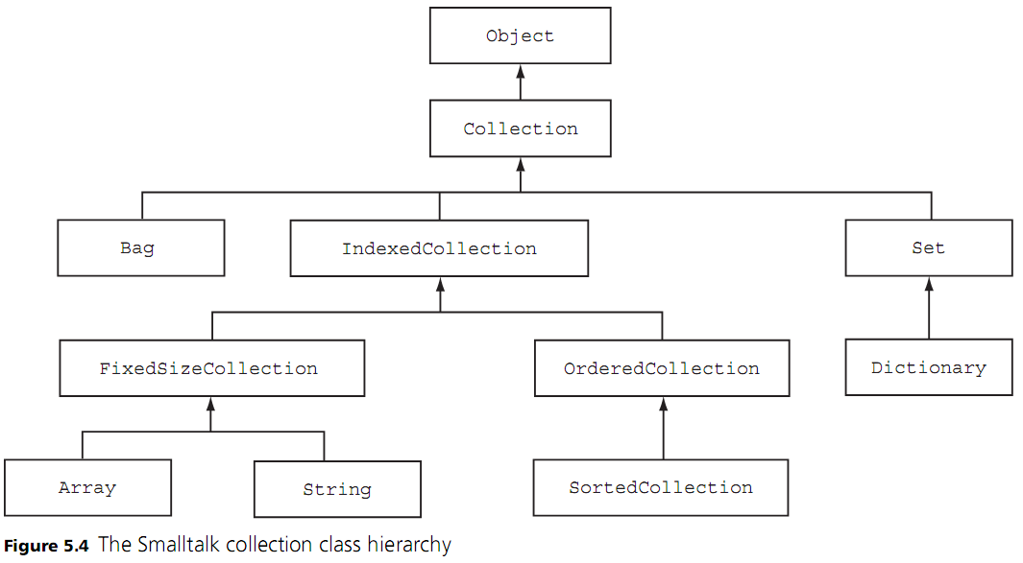
The Collection Hierarchy (cont’d.)
Programming Languages, Third Edition

Slide 32
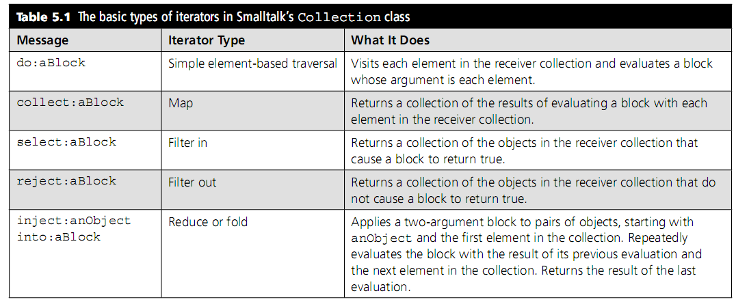
The Collection Hierarchy (cont’d.)
Programming Languages, Third Edition

Slide 33
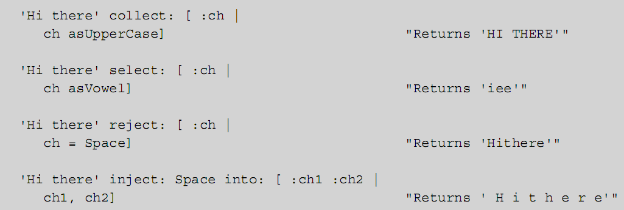
The Collection Hierarchy (cont’d.)
Smalltalk iterators are highly polymorphic
  Can work with any types of collections
Programming Languages, Third Edition

Slide 34
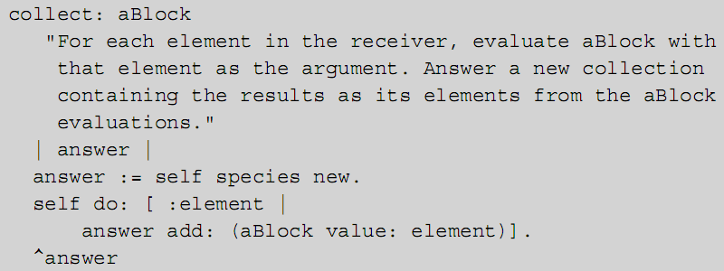
The Collection Hierarchy (cont’d.)
Smalltalk iterators rely on the methods do: and add:
  Example: collect: iterator, polymorphic equivalent of a map in functional languages
Programming Languages, Third Edition

Slide 35
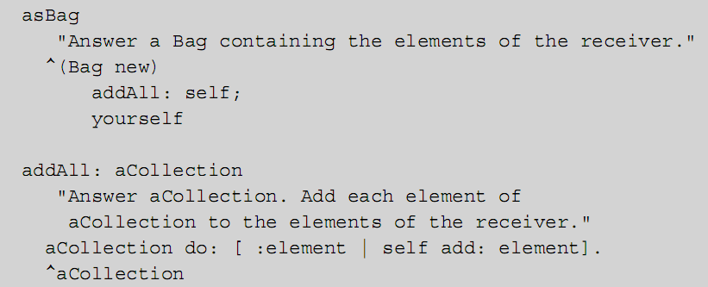
The Collection Hierarchy (cont’d.)
Can convert any type of collection to many of the built-in types of collections
Programming Languages, Third Edition

Slide 36
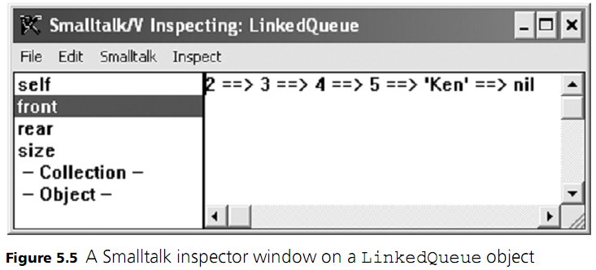
The Collection Hierarchy (cont’d.)
The inspect message opens an inspector window on the receiver object, to browse the values of an object’s instance variables
Programming Languages, Third Edition

Slide 37
Java
Originally intended as a programming language for systems embedded in appliances
  Emphasis was on portability and small footprint: “write once, run anywhere”
Programs compile to machine-independent byte code
Provides conventional syntax, a large set of libraries, and support for compile-time type checking not available in Smalltalk
Is purely object-oriented, with one exception:
  Scalar data types (primitive types) are not objects
Programming Languages, Third Edition

Slide 38
Basic Elements of Java: Classes, Objects, and Methods
A Java program instantiates classes and calls methods to make objects do things
Many classes are available in standard packages
  Programmer-defined classes can be placed in their own packages for import
Variable definition is similar to that in C:
Method call is similar to Smalltalk:
Programming Languages, Third Edition

Slide 39
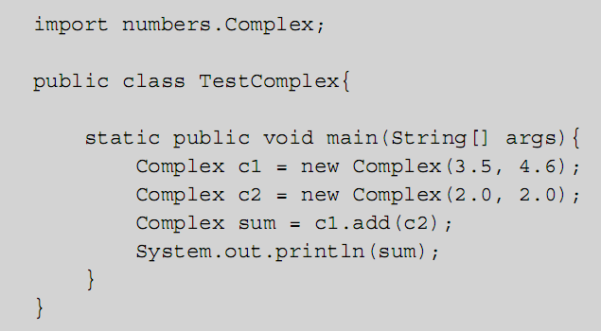
Basic Elements of Java (cont’d.)
Example: program uses an imported class
Programming Languages, Third Edition

Slide 40
Basic Elements of Java (cont’d.)
Class method: a static method
Java Virtual Machine runs the program as TextComplex.main(<array of strings>)
  Command-line arguments present at launch are placed into the args array
All classes inherit from the Object class by default
Data encapsulation is enforced by declaring instance variables with private access
  They are visible only within the class definition
Accessor methods: allow programs to view but not modify the internal state of a class
Programming Languages, Third Edition

Slide 41
Basic Elements of Java (cont’d.)
Constructors: like methods, they specify initial values for instance variables and perform other initialization actions
  Default constructor: has no parameters
  Constructor chaining: when one constructor calls another
Use of private access to instance variables and accessor methods allows us to change data representation without disturbing other code
Java uses reference semantics
  Classes are also called reference types
Programming Languages, Third Edition

Slide 42

Basic Elements of Java (cont’d.)
== is the equality operator for primitive types, and also means object identity for reference types
  Object class contains an equals method that can be overridden in subclasses to implement a comparison of two distinct objects
Methods are invoked after instantiation using dot notation:
Can nest operations:
Java does not allow operator overloading like C++
Java does not allow multimethods, in which more than one object can be the target of a method call
Programming Languages, Third Edition

Slide 43
The Java Collection Framework: Interfaces, Inheritance, and Polymorphism
Framework: a collection of related classes
java.util package: contains the Java collection framework
Interface: a set of operations on objects of a given type
  Serves as the glue that connects components in systems
  Contains only type name and a set of public method headers; implementer must include the code to perform the operations
Programming Languages, Third Edition

Slide 44
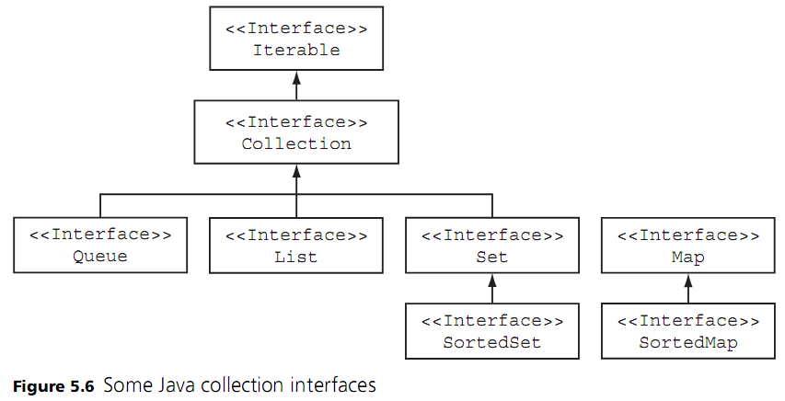
The Java Collection Framework (cont’d.)
Programming Languages, Third Edition

Slide 45
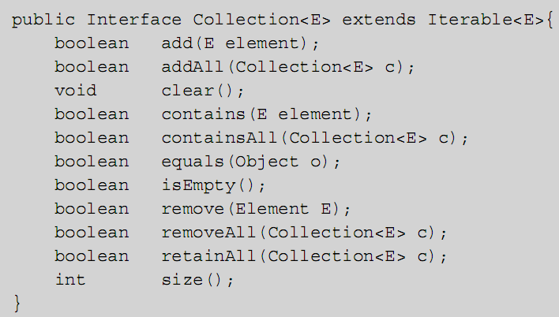
The Java Collection Framework (cont’d.)
Programming Languages, Third Edition

Slide 46

The Java Collection Framework (cont’d.)
<E> and E in the interface and method headers are type parameters
Java is statically typed: all data types must be explicitly specified at compile time
Generic collections: exploit parametric polymorphism
  Raw collections in early versions of Java did not
Examples:
Programming Languages, Third Edition

Slide 47
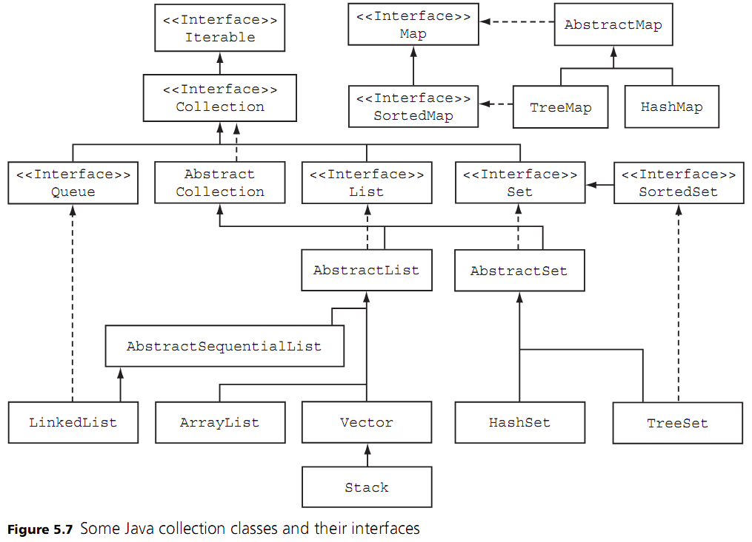
Programming Languages, Third Edition

Slide 48

The Java Collection Framework (cont’d.)
Some classes, such as LinkedList, implement more than one interface
  A linked list can behave as a list or as a queue
Same methods can be called on the two List variables even though they have different implementations and different element types
Can only call Queue interface methods on the queueOfFloats variable because it is type Queue
Programming Languages, Third Edition

Slide 49
The Java Collection Framework (cont’d.)
Example: develop a new type of stack class called LinkedStack, as a subclass of the AbstractCollection class
  Gives us a great deal of additional behavior for free
Private inner class: a class defined within another class
  No classes outside of the containing class need to use it
Java Iterable interface only contains the iterator method
Programming Languages, Third Edition

Slide 50
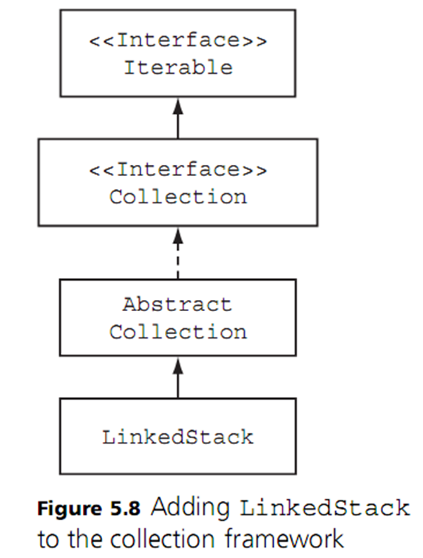
The Java Collection Framework (cont’d.)
Programming Languages, Third Edition

Slide 51
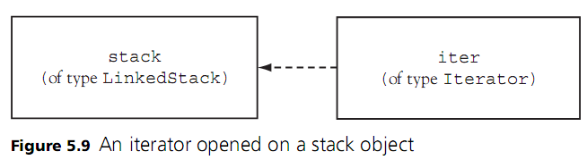
The Java Collection Framework (cont’d.)
Backing store: the collection object on which the iterator object is operating
Example:
Programming Languages, Third Edition

Slide 52
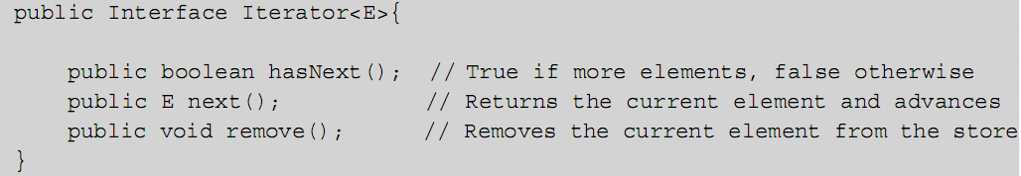

The Java Collection Framework (cont’d.)
Iterator type is parameterized for the same element type as its backing store
  Is an interface that specifies three methods
To visit each element in the backing store, use hasNext and next methods
Programming Languages, Third Edition

Slide 53

The Java Collection Framework (cont’d.)
Java’s enhanced for loop is syntactic sugar for the iterator-based while loop
  Only prerequisites to use this: the collection class must implement the Iterable interface and implement an iterator method
Example:
Programming Languages, Third Edition

Slide 54
Dynamic Binding and Static Binding
Static binding: process of determining at compile time which implementation of a method to use by determining the object’s actual class
  Actual code is not generated by the compiler unless the method is declared as final or static
When Java cannot determine the object’s method at compile time, dynamic binding is used
Java uses a jump table, which is more efficient than a search of an inheritance tree to perform dynamic binding
Programming Languages, Third Edition

Slide 55
Defining Map, Filter, and Reduce in Java
Map, filter, and reduce are higher-order functions in a functional language
  Built-in collection methods in Smalltalk
It is possible to define map, filter, and reduce methods in Java using its basic iterator
  Are defined as static methods in a special class named Iterators
map and filter methods expect an input collection and return an output collection as a value
  The actual object returned will be of the same concrete class as the input collection
Programming Languages, Third Edition

Slide 56
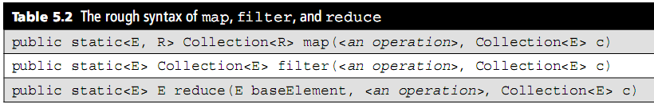
Defining Map, Filter, and Reduce in Java (cont’d.)
How do you represent the operation that is passed as the remaining argument to these methods?
In Java, we can define the operation as a special type of object that recognizes a method that will be called within the higher-order method’s implementation
Programming Languages, Third Edition

Slide 57
Defining Map, Filter, and Reduce in Java (cont’d.)
Three operations are needed:
  In map, a method of one argument that transforms a collection element into another value (perhaps of a different type)
  In filter, a method of one argument that returns a Boolean value
  In reduce, a method of two arguments that returns an object of the same type
Example of next slide
Programming Languages, Third Edition

Slide 58
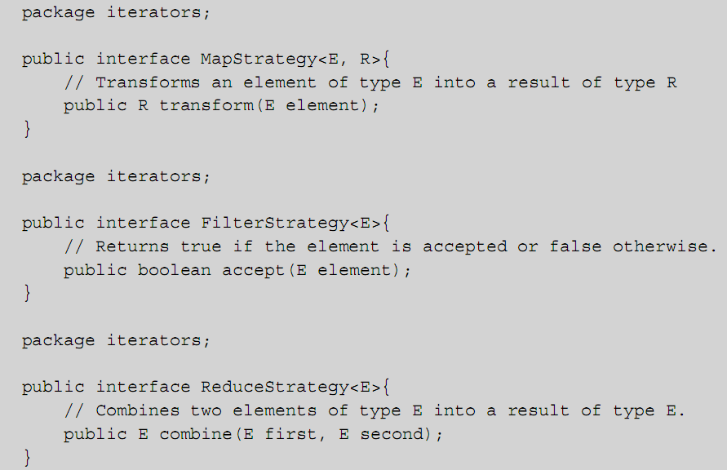
Programming Languages, Third Edition

Slide 59
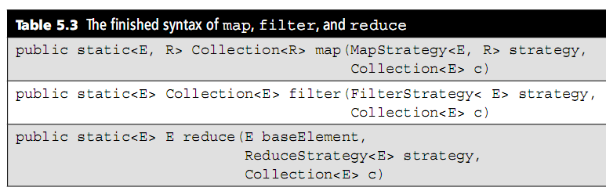
Defining Map, Filter, and Reduce in Java (cont’d.)
These strategy interfaces tell the implementer to expect an object that recognizes the appropriate method
  Tell the user that he must only supply an object of a class that implements one of these interfaces
Programming Languages, Third Edition

Slide 60
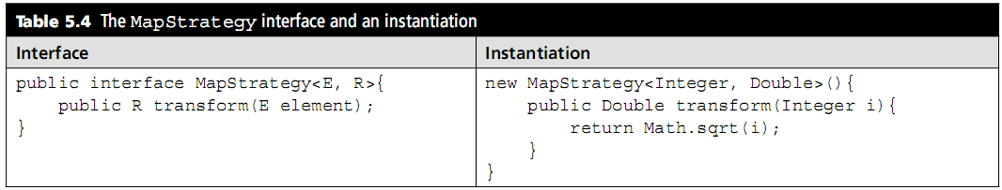
Defining Map, Filter, and Reduce in Java (cont’d.)
The Map Strategy interface and an example instantiation:
Programming Languages, Third Edition

Slide 61
Defining Map, Filter, and Reduce in Java (cont’d.)
Comparing Java versions of map, filter, and reduce to other languages:
  Functional versions are simple: they accept other functions as arguments, but they are limited to list collections
  Smalltalk versions are polymorphic over any collections and no more complicated than that of a lambda form
  Java syntax is slightly more complicated
Real benefit of Java is the static type checking, which makes the methods virtually foolproof
Programming Languages, Third Edition

Slide 62
C++
C++ was originally developed by Bjarne Stroustrup at AT&T Bell Labs
It is a compromise language that contains most of the C language as a subset, plus other features, some object-oriented, some not
Now includes multiple inheritance, templates, operator overloading, and exceptions
Programming Languages, Third Edition

Slide 63
Basic Elements of C++: Classes, Data Members, and Member Functions
C++ contains class and object declarations similar to Java
Data members: instance variables
Member functions: methods
Derived classes: subclasses
Base classes: superclasses
Objects in C++ are not automatically pointers or references
  Class data type in C++ is identical to the struct or record data type of C
Programming Languages, Third Edition

Slide 64
Basic Elements of C++ (cont’d.)
Three levels of protection for class members:
  Public members are accessible to client code and derived classes
  Protected members are inaccessible to client code but are accessible to derived classes
  Private members are inaccessible to client and to derived classes
Keywords private, public, and protected establish blocks in class declarations, rather than apply only to individual member declarations (like in Java)
Programming Languages, Third Edition

Slide 65
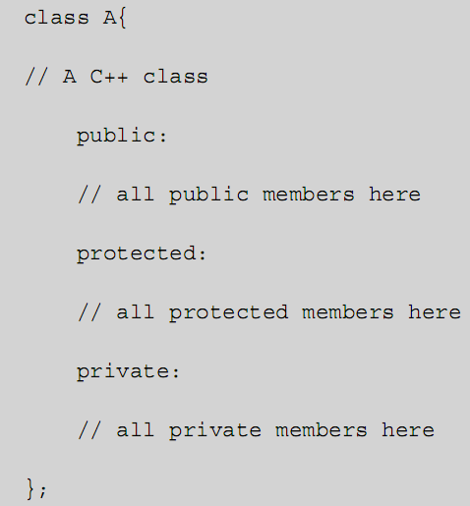
Basic Elements of C++ (cont’d.)
Programming Languages, Third Edition

Slide 66
Basic Elements of C++ (cont’d.)
Constructors: initialize objects as in Java
  Can be called automatically as part of a declaration, as well as in a new expression
Destructors: called when an object is deallocated
  Name is preceded the tilde symbol (~)
  Required because there is no built-in garbage collection in C++
Member functions can be implemented outside the declaration by using the scope resolution operator :: after a class name
Programming Languages, Third Edition

Slide 67

Basic Elements of C++ (cont’d.)
Member functions with implementations in a class are assumed to be inline
  Compiler may replace the function call with the actual code for the function
Instance variables are initialized after a colon in a comma-separated list between the constructor declaration and body, with initial values in parentheses
Programming Languages, Third Edition

Slide 68

Basic Elements of C++ (cont’d.)
Constructor is defined with default values for its parameters
  This allows objects to be created with 0 to all parameters declared and avoids the need to create overloaded constructors
Example:
Programming Languages, Third Edition

Slide 69
Using a Template Class to Implement a Generic Collection
Template classes: used to define generic collections in C++
Standard template library (STL) of C++ includes several built-in collection classes
Example: using a C++ LinkedStack class, created with the same basic interface as the Java version presented earlier in the chapter
  The new LinkedStack object is automatically created and assigned to the stack variable upon the use of that variable in the declaration
Programming Languages, Third Edition

Slide 70
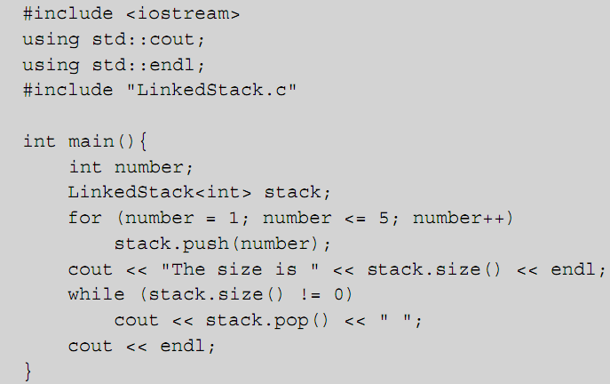
Using a Template Class to Implement a Generic Collection (cont’d.)
Programming Languages, Third Edition

Slide 71
Using a Template Class to Implement a Generic Collection (cont’d.)
Template class is created with keyword template in the class header
  Example: template <class E>
Because this class will utilize dynamic storage for its nodes, it should include a destructor
Programming Languages, Third Edition

Slide 72
Static Binding, Dynamic Binding, and Virtual Functions
Dynamic binding of member functions is an option in C++, but not the default
  Only functions defined with the keyword virtual are candidates for dynamic binding
Pure virtual declaration: a function declared with a 0 and the keyword virtual
  Example:
  Function is abstract and cannot be called
  Renders the containing class abstract
  Must be overridden in a derived class
Programming Languages, Third Edition

Slide 73
Static Binding, Dynamic Binding, and Virtual Functions (cont’d.)
Once a function is declared as virtual, it remains so in all derived classes in C++
Declaring a method as virtual is not sufficient to enable dynamic binding
  Object must be either dynamically allocated or otherwise accessed through a reference
C++ offers multiple inheritance using a comma-separated list of base classes
  Example:
Programming Languages, Third Edition

Slide 74
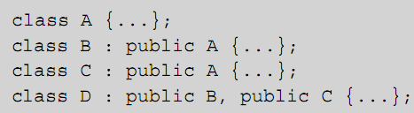
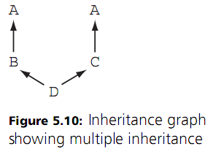
Static Binding, Dynamic Binding, and Virtual Functions (cont’d.)
Multiple inheritance ordinarily creates separate copies of each class on an inheritance path
  Example: object of class D has two copies of class A
This is called repeated inheritance
Programming Languages, Third Edition

Slide 75
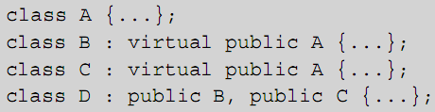
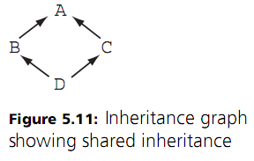
Static Binding, Dynamic Binding, and Virtual Functions (cont’d.)
To get a single copy of A in class D, must use the virtual keyword, causing shared inheritance
Programming Languages, Third Edition

Slide 76
Design Issues in Object-Oriented Languages
Object-oriented features represent dynamic rather than static capabilities
  Must introduce features in a way to reduce the runtime penalty of the extra flexibility
Inline functions are an efficiency in C++
Other issues for object-oriented languages are the proper organization of the runtime environment and the ability of a translator to discover optimizations
Design of the program itself is important to gain maximum advantage of an object-oriented language
Programming Languages, Third Edition

Slide 77
Classes vs. Types
Classes must be incorporated in some way into the type system
Three possibilities:
  Specifically exclude classes from type checking: objects would be typeless entities
  Make classes type constructors: classes become part of the language type system (adopted by C++)
  Let classes become the type system: all other structured types are then excluded from the system
Programming Languages, Third Edition

Slide 78
Classes vs. Modules
Classes provide a versatile mechanism for organizing code
  Except in Java, classes do not allow the clean separation of implementation from interface and do not protect the implementation from exposure to client code
Classes are only marginally suited for controlling the importing and exporting of names in a fine-grained way
  C++ uses a namespace mechanism
  Java uses a package mechanism
Programming Languages, Third Edition

Slide 79
Inheritance vs. Polymorphism
Four basic kinds of polymorphism:
  Parametric polymorphism: type parameters remain unspecified in declarations
  Overloading (ad hoc polymorphism): different function or method declarations share the same name but have different types of parameters in each
  Subtype polymorphism: all operations of one type can be applied to another type
  Inheritance: a kind of subtype polymorphism
Programming Languages, Third Edition

Slide 80
Inheritance vs. Polymorphism (cont’d.)
Double-dispatch (or multi-dispatch) problem: inheritance and overloading do not account for binary (or n-ary) methods that may need overloading based on class membership in two or more parameters
In C++, may need to define a free (overloaded) operator function
Attempts to solve this problem use multimethods: methods that can belong to more than one class or whose overloaded dispatch can be based on class membership of several parameters
Programming Languages, Third Edition

Slide 81
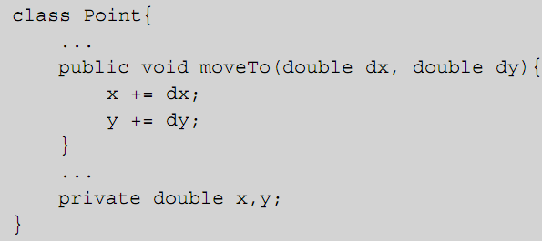
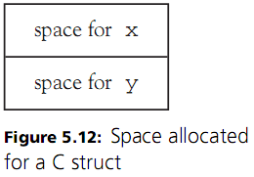
Implementation of Objects and Methods
Objects are typically implemented exactly as record structures would be in C or Ada
  Instance variables represent data fields in the structure
  Example:
Programming Languages, Third Edition

Slide 82
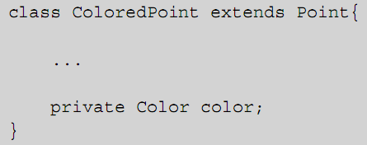
Implementation of Objects and Methods
An object of a subclass can be allocated as an extension of the preceding data object, with new instance variables allocated space at the end of the record
  Example:
Programming Languages, Third Edition

Slide 83
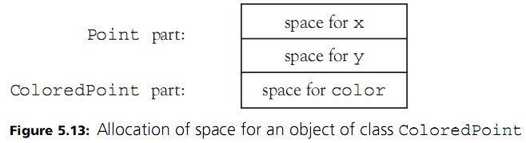
Implementation of Objects and Methods
By allocating at the end, the instance variables of the base class can be found at the same offset from the beginning of the allocated space as for any object of the base class
Programming Languages, Third Edition

Slide 84
Inheritance and Dynamic Binding
Only space for instance variables is allocated with each object
  Not provided for methods
This becomes a problem when dynamic binding is used for methods
  The precise method to use for a call is not known except during execution
Possible solution is to keep all dynamically bound methods as extra fields directly in the structures allocated for each object
Programming Languages, Third Edition

Slide 85
Allocation and Initialization
Object-oriented languages such as C++ maintain a runtime environment in the traditional stack/heap fashion of C
This makes it possible to allocate objects on either the stack or the heap
  Java and Smalltalk allocate them on the heap
  C++ permits an object to be allocated either directly on the stack or as a pointer
Smalltalk and Java have no explicit deallocation routines but use a garbage collector
  C++ uses destructors
Programming Languages, Third Edition

